Slide 1

Natural Language Processing Project
Recipe Search Application
Presenter: 20140313 양인수
TEAM 자연어버억
MEMBERS:
20163704 박주현
20164245 홍진
20140490 이동규
20176058 박시현
20142748 이강희
20140313 양인수
Notes:
本PPT模板部分元素使用了幻灯片母版制作。如果需要修改，点击-视图-幻灯片母版-修改；完成后关闭编辑母版即可。

Slide 2
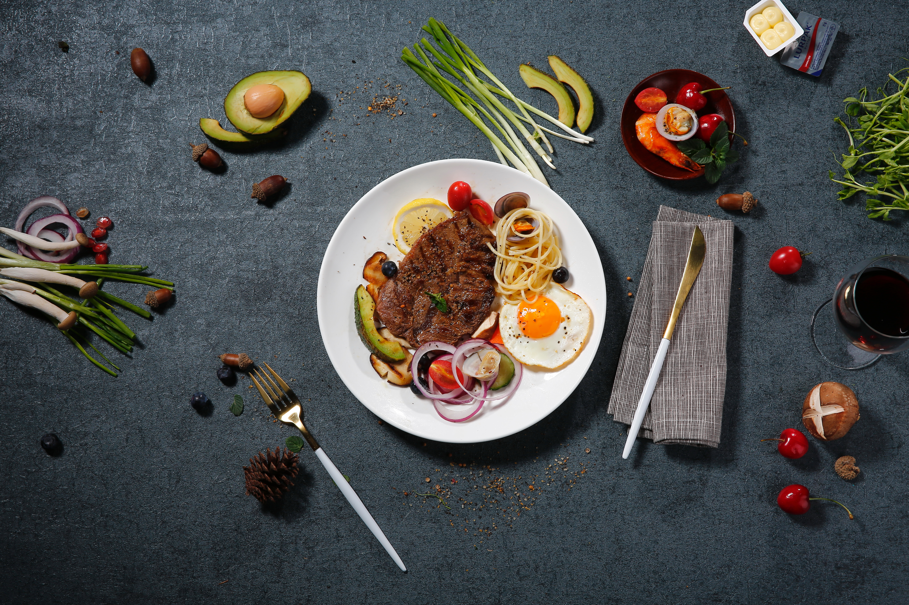
01 Introduction
02 Objectives
CONTENTS
03 Solution
04 Progress Plans

Slide 3
01
Introduction
Topic Motive
Problem Deduction

Slide 4

Topic Motives
Indexed by the name of the dishes.
2. Brief descriptions of the food.
3. Mainly focuses on instructions.

Slide 5

Problem Deduction
?
Hot chicken soup with that I ate when I traveled to Korea?
Recipe books cannot understand natural language.
Without knowing the name of the dish, user needs cannot be satisfied.

Slide 6
02
Objectives
Primary Function
Development

Slide 7


Primary Function
NL query
Matching
Dish
Building a system that understands natural language query.
Specifically answering in range of food.

Slide 8

Development
Android Application
Language Processor
- User-friendly interface
- Processes Query
- Takes in user query
- Contains Database
- Displays top-matching results
- Utilizes Machine Learning

Slide 9
03
Solution
Database System
Query Processing

Slide 10
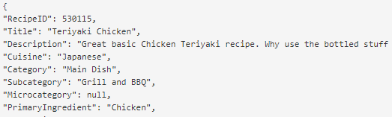

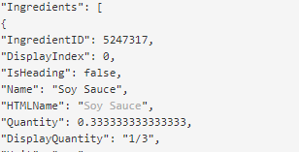
Database System

Slide 11
Database System
Description
Food
Make a deep learning model that outputs match the descriptions from the API to the according food.

Slide 12
Query Processing
Q. Warm chicken soup from Korea?
WORD2VEC
Hot, Boiling, Fire
Word2vec model returns closest meanings according to the input.

Slide 13
Information Retrieval
Hot, Boiling, Fire
삼계탕
Q. Hot chicken soup from Korea?

Slide 14

Flow Chart
1. Query Processing
2. Database Processing

Slide 15
04
Progress Plans
Role Division

Slide 16
Role Division
01
Data Mining
(All)
Server Development
(홍진)
02
23%
35%
Machine Learning Model
03
56%
(이강희, 양인수)
44%
04
Query Processing
(이동규, 박시현)
05
Front Development (박주현)

Slide 17
Schedule
WEEK 1
WEEK 2
WEEK 3
WEEK 4
01
02
03
04
WEEK 1
WEEK 2
WEEK 3
WEEK 4
Data Mining
Data Processing
Query Processing
(Machine Learning)
Server Development
Front Development

Slide 18
Thank You.
This is the end of our presentation.
Notes:
本PPT模板部分元素使用了幻灯片母版制作。如果需要修改，点击-视图-幻灯片母版-修改；完成后关闭编辑母版即可。

